Slide 1
Topic- Network Performance Monitoring Tool (NPM) Date: 02-04-2026
REVA Academy for Corporate Excellence (RACE)
Rajendra Rathod
FT – 04 (M tech in Cyber Security)
Networking Fundamentals
www.race.reva.edu.in

Slide 2
Contents
01
Introduction
04
Tools
02
05
System Architecture
Problem Statement
.
03
Objectives
06
Conclusion

Slide 3
Introduction
Network performance refers to how efficiently and reliably a computer network transfers data between devices. It determines the speed, quality, and stability of communication in systems like the internet, enterprise networks, and cloud platforms.
A Network Performance Monitoring Tool (NPM) is a system used to monitor, analyze, and optimize network performance in real time.
It tracks important metrics like latency and bandwidth, detects issues quickly, and ensures smooth and secure network communication.
Ensures smooth communication between devices and systems.

Slide 4
Problem Statement
Modern computer networks often experience issues such as high latency, packet loss, and bandwidth congestion, which can degrade performance and affect user experience. However, without real-time monitoring tools, it becomes difficult to detect, analyze, and resolve these problems efficiently.
This can lead to network downtime, reduced productivity, and potential security risks due to unnoticed abnormal activities. Therefore, there is a need for an automated Network Performance Monitoring Tool that can continuously monitor network health, provide real-time insights, and generate alerts for timely issue resolution.

Slide 5
Objectives
-To develop a Network Performance Monitoring Tool (NPM) for real-time network analysis
-To provide real-time visualization of network performance
-To monitor key metrics such as latency, bandwidth usage, and packet loss
-To detect network issues and generate instant alerts

Slide 6
Performance Factor
Latency (Delay)
Time taken for data to travel from source → destination (usually in milliseconds).
Detects slow response times
Important for real-time apps (video calls, gaming)
High latency = delays, lag, poor user experience
Bandwidth Usage
Amount of data being transmitted over the network (Mbps/Gbps).
Shows network capacity usage
Helps identify heavy traffic, Detects unusual activity
Packet Loss
Percentage of data packets that fail to reach destination.
Indicates data reliability
High packet loss = broken communication

Slide 7
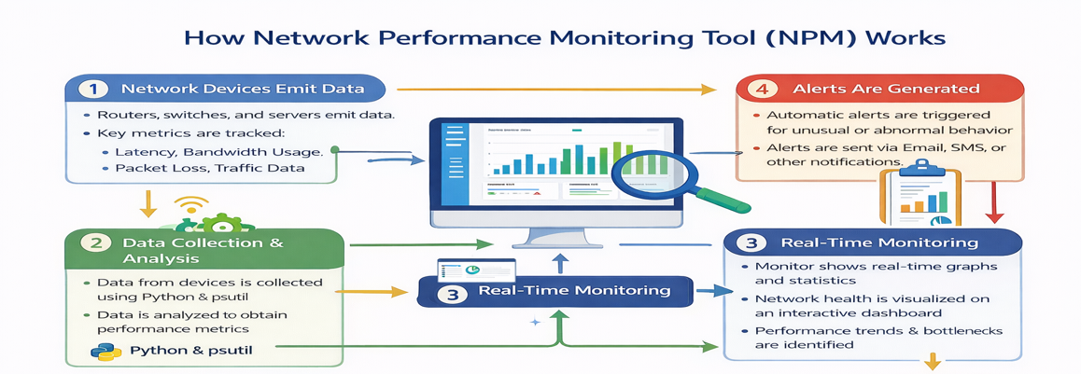
Tool WorkFlow

Slide 8
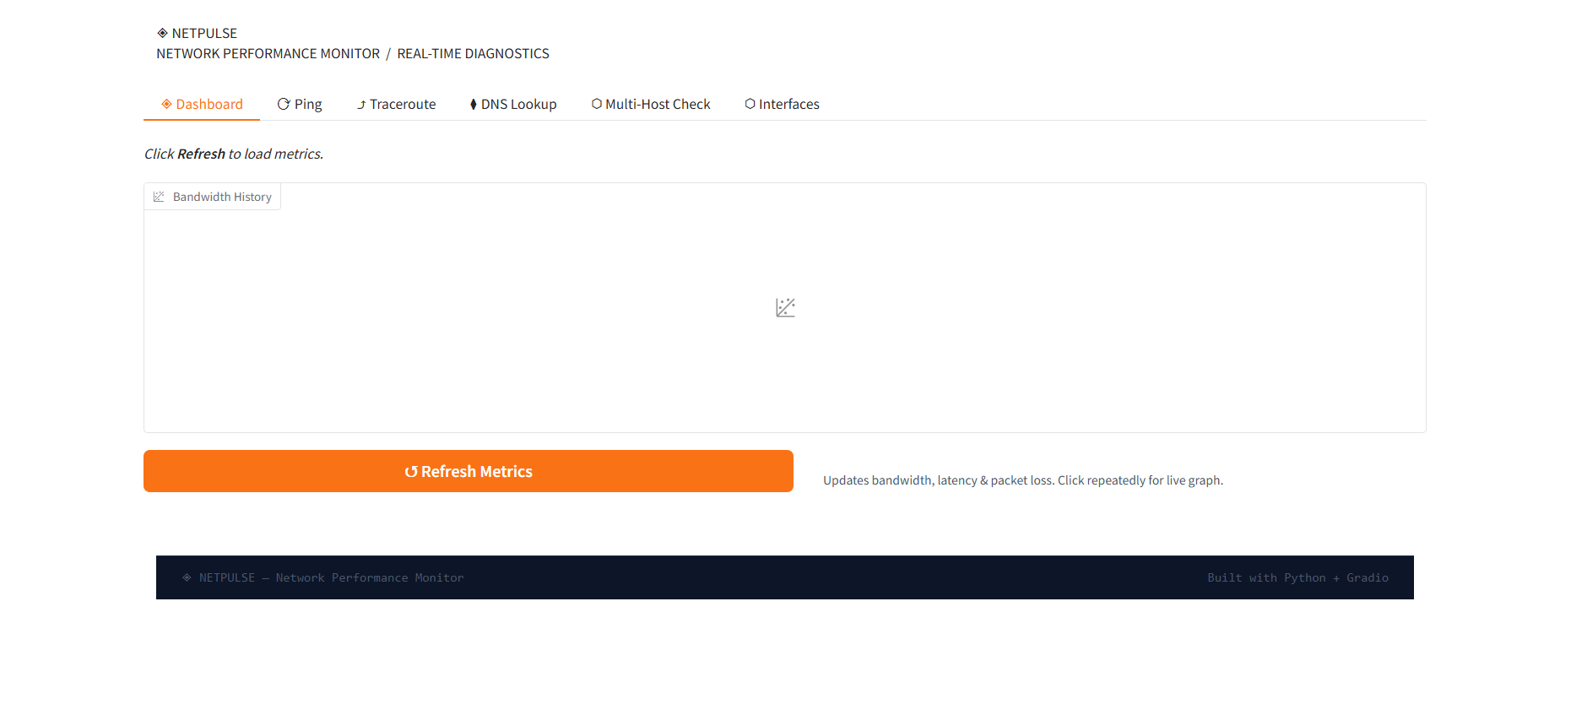
Tool WorkFlow Interface
Bandwidth History
A graph area showing network usage over time
Tracks:
Upload speed
Download speed
Helps identify:
Traffic spikes
Heavy usage patterns
Tests connectivity to a server (like Google)
Measures:
Latency (m)s
Whether the server is reachable
Helps detect network delay and downtime
Tracks the path (hops) data takes from your system to a destination
Helps identify:
Where delay is happening
Which router is causing issues
Converts a domain name → IP address
Example: google.com → 142.x.x.x
Helps detect:
DNS delays
Suspicious or slow domain resolutions
Multi-Host Check
Tests multiple servers at once
Useful for:
Checking availability of different websites/services Comparing performance across servers.

Slide 9
Outcome
-Network performance can be improved by optimizing latency, bandwidth usage, and packet reliability through proper configuration, monitoring, and hardware improvements
-To improve network performance:
Reduce latency
Optimize bandwidth
Minimize packet loss
Problem | Solution
Slow internet | Reduce bandwidth usage
Video buffering | Fix packet loss
Gaming lag | Reduce latency

Slide 10
Conclusion
The Network Performance Monitoring Tool provides an effective solution for
real-time monitoring and analysis of network performance.
It helps in tracking key metrics like latency, bandwidth usage, and packet loss.
The system enables quick detection of network issues and generates alerts for timely action .
Integration of machine learning enhances the ability to detect anomalies and unusual patterns(Still understanding the Concept)
The tool improves overall network reliability, efficiency, and security.
It can be further enhanced for large-scale and enterprise-level applications.

Slide 11


